Slide 1
Psychology of Infancy
Advanced Developmental Psychology
PSY 430
PSY 620P

Slide 2
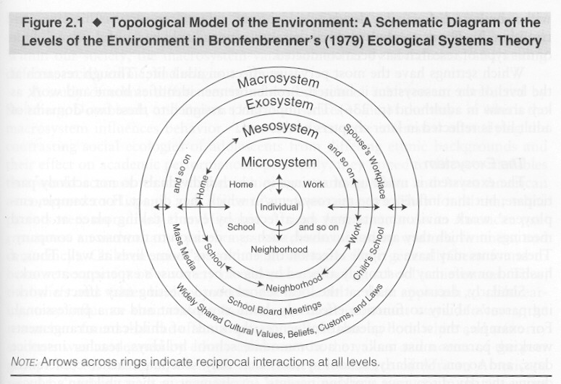
Domains of Development
Perception
Cognition
Language
Social/Emotional

Slide 3
Overview: Quality language experience predicts
Contingent feedback changes how infants vocalize
What would Chomsky think (what about Romeo et al’s results)?
SES, parent speech, and child language outcome
Hart & Risley’s classic—parental speech & SES
Hoff—maternal speech vs SES
Romeo—Vocal turn-taking and brain development
Hirsh-Pasek-quality of speech (fluency & connectedness)
Hearing loss
Age at implantation
Quittner—Strategies for deaf parents
Debbie school peer & teacher results
Other experiential constraints
First words
High-chair learning

Slide 4
Distinguishing between non-native speech sounds in 1st year
At birth, infants are capable of discriminating all phonetically relevant differences in the world’s languages
They perceptually partition the acoustic space underlying phonetic distinctions in a universal way.
By 6 months of age, infants raised in different linguistic environments show an effect of language experience.
Their representations are becoming language specific

Slide 5
Development involves relatively permanent change, not improvement in all things.
English-learning infants hear Hindi contrast better than English-speaking adults
Almost as well as adult Hindi-speakers

Slide 6
Consider the spoken tokens of “doll.”
To a Hindi speaker, the difference between the “d” sounds in “this doll” versus “your doll”—a phonetic contrast between a dental [d̪al] versus a retroflex [ɖal], respectively—would signal two possible word forms (either lentils or branch).
In English, both of those “d” sounds signal just one possible word form—phonetically labeled as an alveolar [dal].

Slide 7
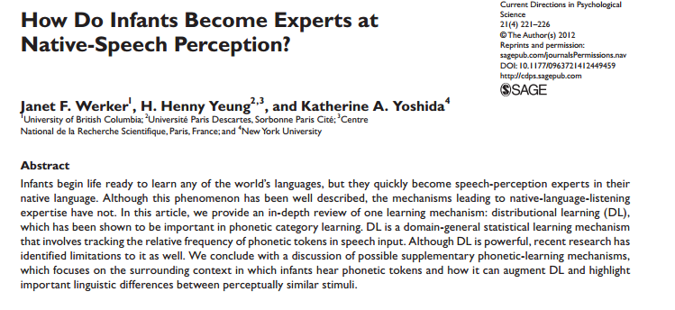

Slide 8
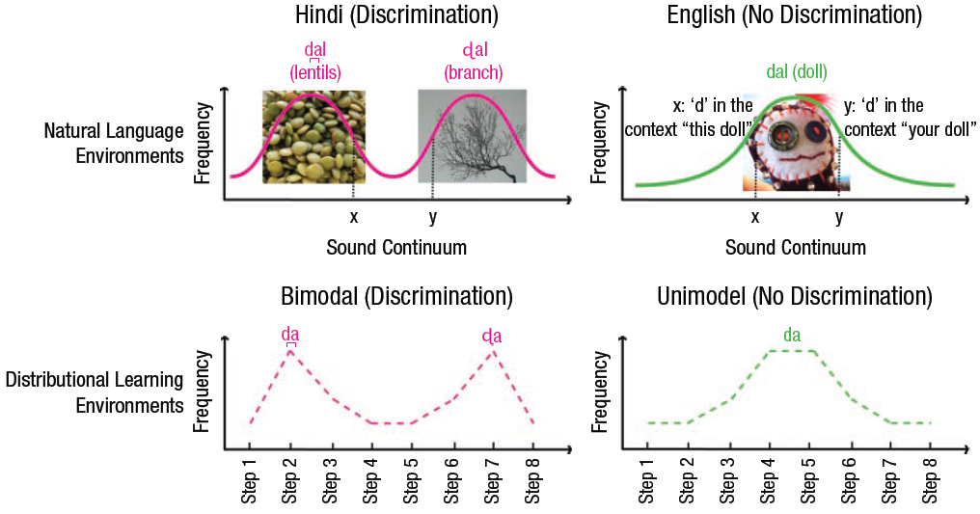
Different languages provide different phonetic experiences
Notes:
Fig. 1. An illustration of distributional learning and acquired distinctiveness. The top panel illustrates the variability around the pronunciation
of “d” an infant might hear in a natural-language environment, depending on whether the infant is growing up learning Hindi (left) or English
(right). The middle panel illustrates how this variability is modeled using relative frequencies of sounds that are created along an 8-step
continuum from dental [d̪a] to retroflex [ɖa], as used in studies of distributional learning. The bottom panel illustrates how this variability is
modeled in studies of acquired distinctiveness: Two consistent sound-object pairings are presented to highlight the distinction between [d̪a]
and [ɖa] in comparison to inconsistent pairings. Image of lentils: FoodStories (2009). Retrieved from Flickr: http://www.flickr.com/photos/
foodstories/4016993694/. Image of branch: Andy Magee (2011). Retrieved from Flickr: http://www.flickr.com/photos/amagee3/5394212150/.
Image of doll: elasticcamel (2004). Retrieved from Flickr: http://www.flickr.com/photos/91524358@N00/2419004722/. All images used with
permission.

Slide 9
Vernon-Feagans et al. (2012)
Early language development predicted by distal risk factors like poverty and maternal education
Proximal processes that link these to child outcomes
Focus on household chaos

Slide 10
Vernon-Feagans et al. (2012)
Large representative sample of children living in low wealth rural communities
Longitudinal design over first 3 years of life
Goals
Structure of household chaos using multiple measurements
Relations of chaos to child language outcomes
Mediating role of positive and negative parenting

Slide 11
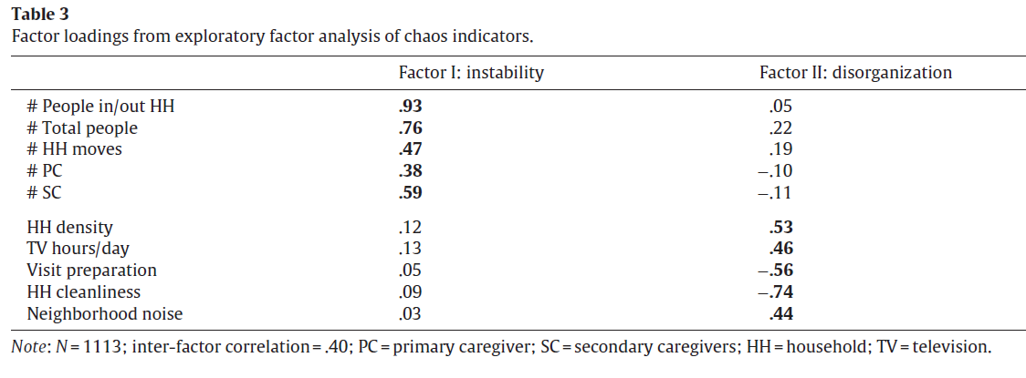
Vernon-Feagans et al. (2012)
Chaos structure

Slide 12
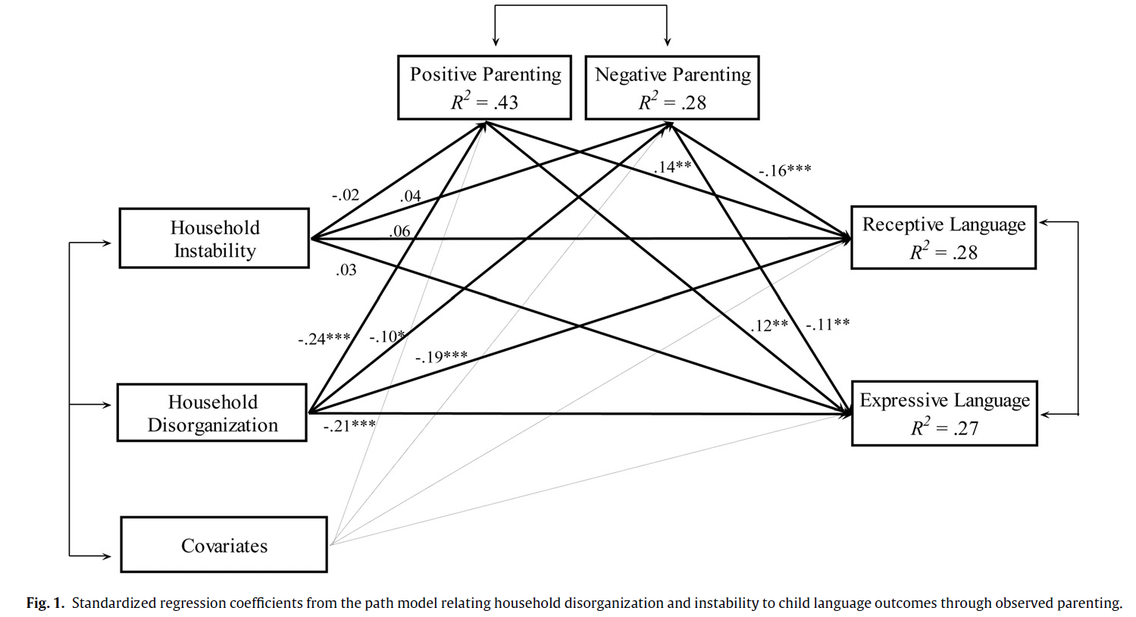
Large representative sample of children living in low wealth rural communities
Vernon-Feagans et al. (2012)

Slide 13
Socioeconomic status differences in language experience are associated with later child language competence and IQ
Meaningful differences in the everyday experiences of young American children. Hart & Risley (1995). Baltimore, MD: Brookes Publishing Co

Slide 14
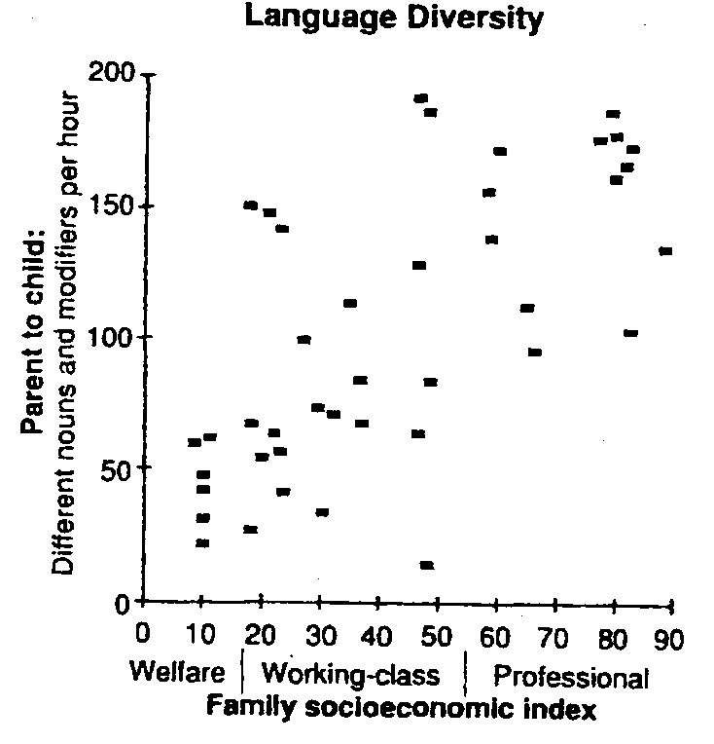
Quantity of language: Nouns, adjectives, and adverbs to child

Slide 15
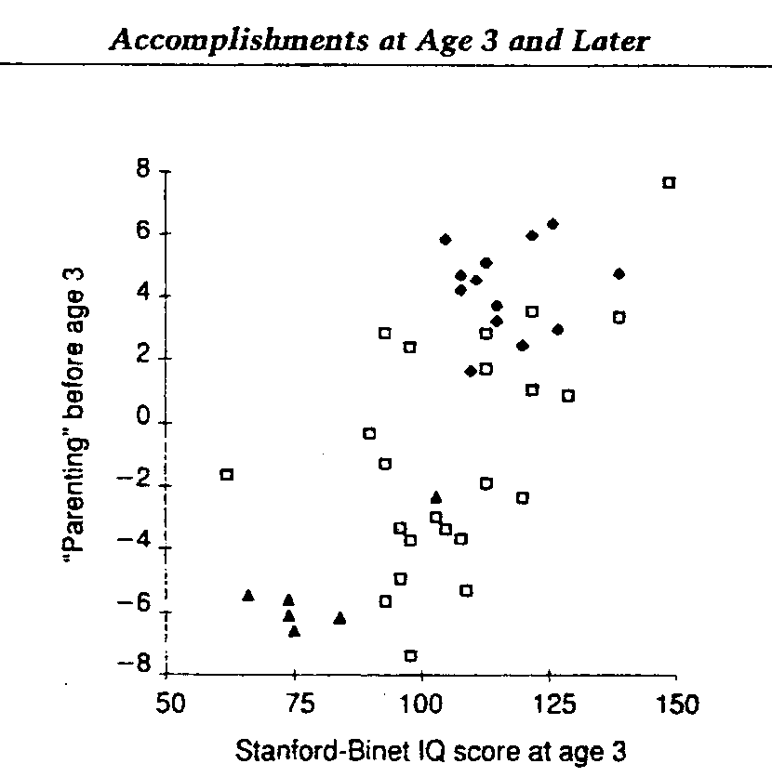
How language experience is associated with later child IQ
“Parenting” = Language diversity + feedback tone + symbolic emphasis + guidance style + responsiveness
Predicts between and within SES groups

Slide 16
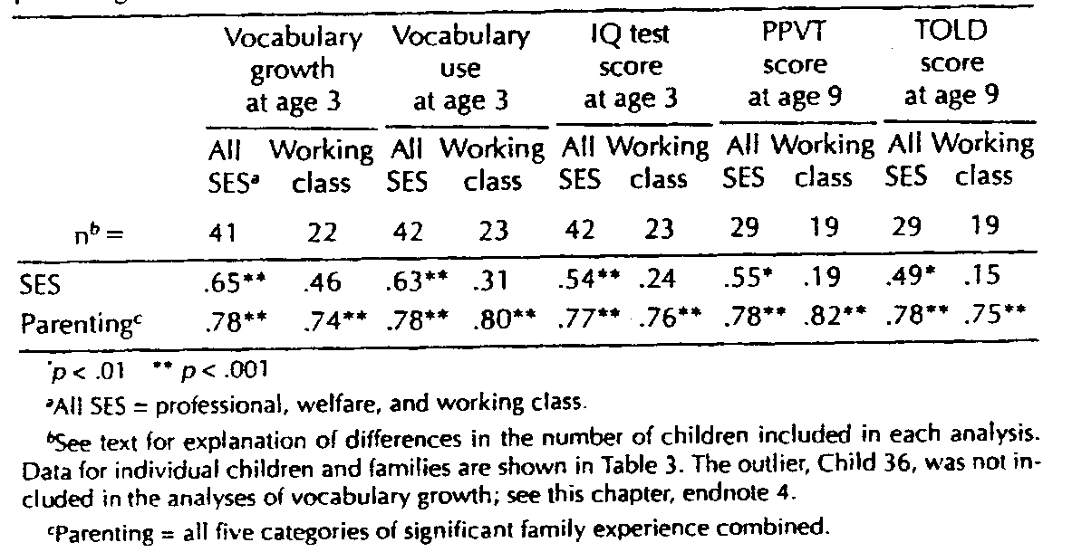
Language experience—not SES—makes the difference

Slide 17
Implications for intervention Hart & Risley
‘Could easily increase the size of the children’s vocabularies, could not accelerate the developmental trajectory.’
“Removing barriers and offering opportunities and incentives is not enough to overcome the past, the transmission across generations of a culture of poverty.”
‘To intervene with vocabulary growth rate … increase the experiences available to the children
Limited success … ultimately the growth rates increased only temporarily.

Slide 18
Support environmental specificity model
Vocabulary development depends on specific properties of language experience
Implies that enriching language experience can increase vocabulary development for low-SES kids

Slide 19
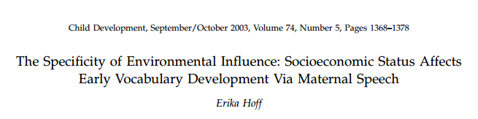
Mean length of utterance (MLU)
Length in morphemes - not words
Smallest unit of meaning in a word
“I running” = 3 morphemes (not 2 words)

Slide 20
Measuring grammatical development (MLU)
Mean length of utterance (MLU) is a measure of syntactic development.
Length in morphemes - not words
Morpheme is the smallest unit of meaning in a word
“I running” = 3 morphemes (not 2 words)
free morpheme: can stand as a word by itself (e.g., kind)
bound morpheme exist only in a word (-ly, -ness, -s, -ed, ‘s)
Each new morpheme reflects new linguistic knowledge.
(Compare phonemic complexity)

Slide 21
Measuring grammatical development (MLU)
Mean length of utterance (MLU) is a measure of syntactic development.
Length in morphemes - not words
Morpheme is the smallest unit of meaning in a word
“I running” = 3 morphemes (not 2 words)
free morpheme: can stand as a word by itself (e.g., kind)
bound morpheme exist only in a word (-ly, -ness, -s, -ed, ‘s)
Each new morpheme reflects new linguistic knowledge.
(Compare phonemic complexity)

Slide 22
Differences in language development across SES
Environment plays a role in language development
Mothers are primary source of language experience
Is the effect of environment global or is there evidence for environmental specificity?
Notes:
Effect of environment global – supportive environment benefits all aspects of development and unsupportive impede them. The fact that the effects of SES are pervasive is consistent with the global effect model
Principle of Environmental specificity – different aspects of the environment affect different aspects of development. E.g. aspects of maternal behavior that predict language development arent the same as those that predict play development

Slide 23
Study Aims & Hypotheses
Explain the relationship between SES and language development through environmental specificity
Identify underlying mechanism of this relationship
Hypotheses
Differences in children’s SES-related language-learning experiences can explain SES differences in vocabulary development
Maternal speech mediates the relationship between SES and vocabulary development

Slide 24
SES versus maternal speech
Participants (N=63)
33 High-SES families
College educated
Employed in professional or managerial positions
30 Mid-SES families
High School education
Employed in unskilled, semiskilled, or service positions
Measures
Maternal Speech
Child Vocabulary
Mediation Model
SES→ Child Vocabulary
SES→ Maternal Speech
Maternal Speech → Child Vocabulary
Strength of relationship between SES and Child Vocabulary reduced
Correlations and Multiple Regression

Slide 25
Maternal speech mediates relationship between SES & vocabulary
SES -> 5% of variance in child vocabulary
SES significantly associated with maternal MLU
MLU -> 22% of variance in child vocabulary
When removed, only 1% of variance explained by SES
So…there are 2 processes going on
1. SES affects maternal speech
Childrearing beliefs
Time availability
2.Maternal speech affects language growth
Provides data for child’s word-learning mechanisms
Longer utterance -> more variance in word types (richer vocabulary)
Longer utterance -> more info about meaning
Longer utterance -> richer syntax

Slide 26
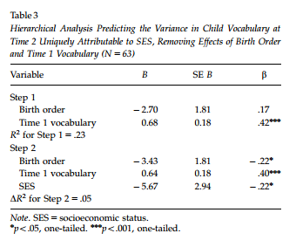
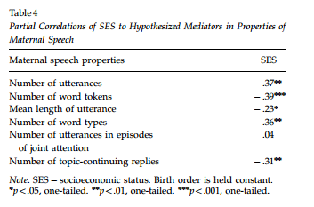
Results
Notes:
Table 3: SES at time 1 assoc with child vocab; accounted for an additional 5% of the variance
Table 4: The high-SES mothers produced more utterances, more word tokens, and more word types; had higher MLUs; and produced more topic continuing replies to their children than did the mid-SES mothers.

Slide 27
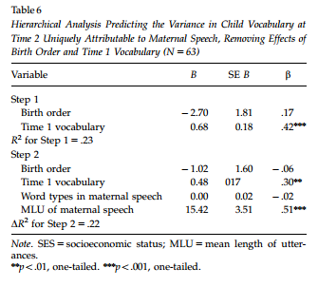
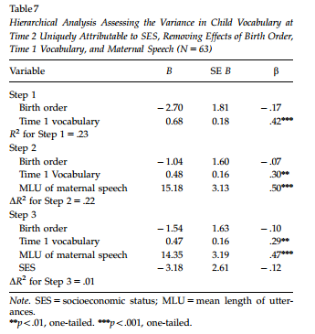
SES → Parenting → Child language
Hoff (2003)

Slide 28
How?
SES affects maternal speech
Childrearing beliefs
Time availability
Maternal speech affects language growth
child’s word-learning mechanisms
Longer utterance -> more variance in word types (richer vocabulary)
Longer utterance -> more info about meaning
Longer utterance -> richer syntax
Maternal speech mediates relationship between SES & vocabulary
Notes:
SES related differences in language use - differences in the quantity, lexical richness, and sentence complexity of mothers’ speech to their children
SES may also be associated with differences in the time available for leisurely parent–child interaction
Children who heard longer utterances built productive vocabularies at faster rates than children who heard shorter utterances

Slide 29
Conclusion
Relationship between SES and language development influenced by language experiences
Evidence for environmental specificity
Enriching language experience can increase vocabulary development for lower SES children
Notes:
one reason children from different social strata use different-sized vocabularies is that they have different language experiences
Argument for specificity: not that any experiential correlate of SES predicts any developmental correlate of SES. Rather, the picture of environmental influence and of SES effects that the present findings suggest is one in which vocabulary development depends on particular properties of language experience.
Implication: Specific remediation should be effective – change language experience of low SES kids, should see and effect on vocab

Slide 30

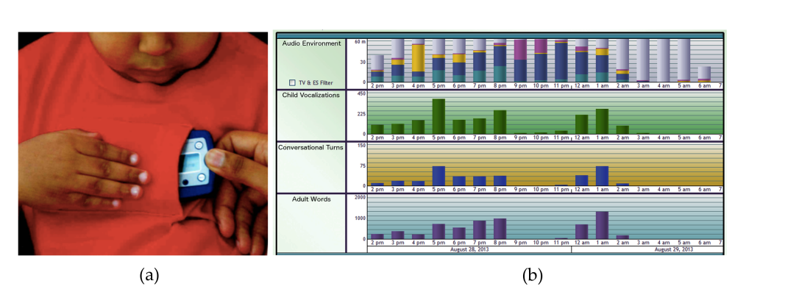

Slide 31
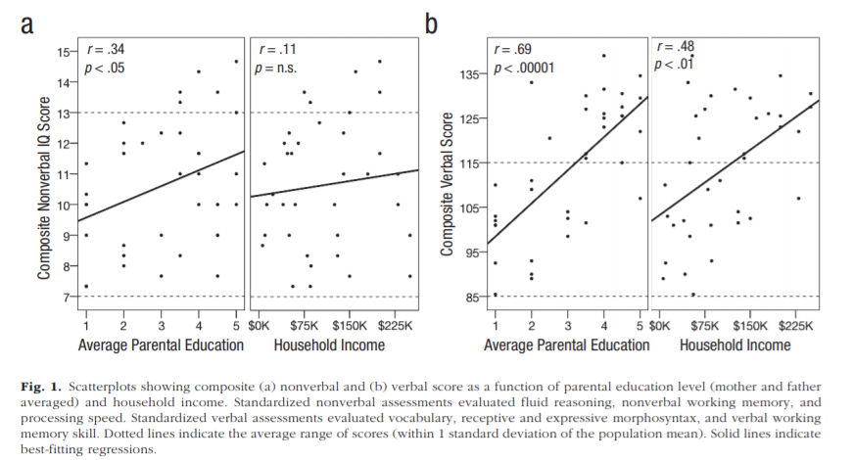
SES→IQ & Verbal Composite

Slide 32
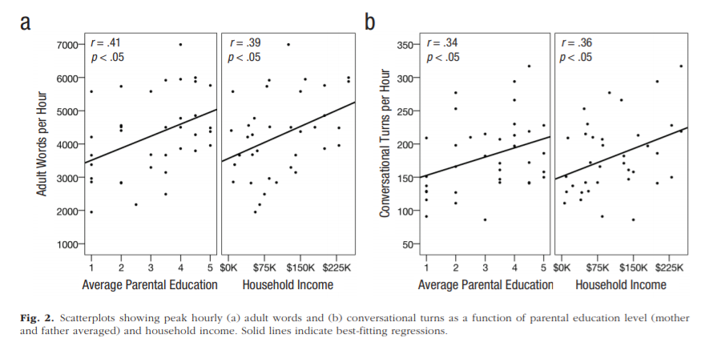
SES→adult words & turn-count

Slide 33
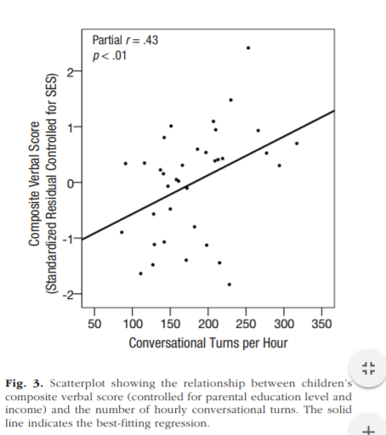
Conversational turns→composite verbal
Composite verbal
scores were created by averaging the PPVT-4 standard
score and the CELF-5 CLS.

Slide 34
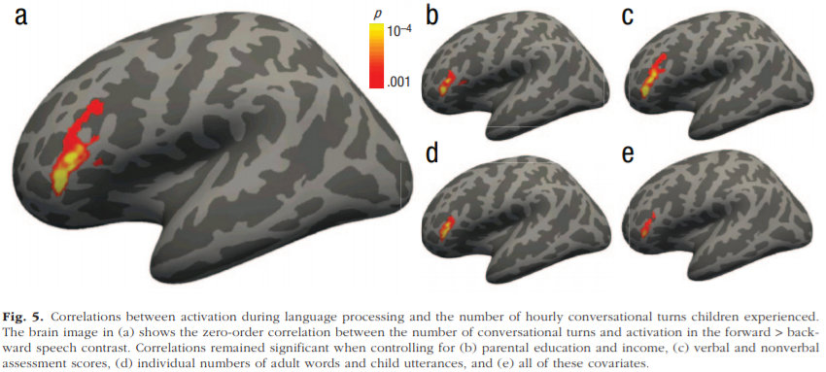
Conversational turns— left inferior frontal gyrus activation

Slide 35
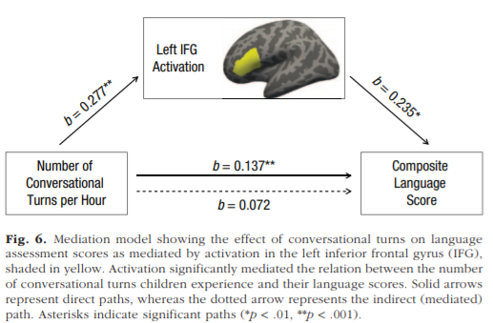
Moderated by left inferior frontal gyrus
What would Chomsky think of these results?

Slide 36
Hirsh-Pasek et al. (2015)
Price
Notes:
”Today, I’m going to be talking about Hirsh Pasek et al.'s article on the contribution of early communication quality for child’s language success in lower income households”

Slide 37
Background
“30 Million Word Gap”
Children in poverty hear significantly fewer words than their more affluent peers
This gap predicts lower intelligence scores, lower vocabulary, and less language-processing efficiency
Quality over quantity!
Since 1977, researchers have argued that the quality of mother-child conversations is a key factor in language growth
Price

Slide 38
Study Aims
“Our goal was to determine whether dyadic features of the communication foundation during interactions between low-income parents and 2-year-old children contribute to variability in language at age 3 years over and above the contributions of variations in the quantity of parents’ verbal input and a measure of sensitive parenting” (Hirsh-Pasek et al., pg 1072).
Price

Slide 39

Key Dyadic Features
Child’s Joint Engagement
Routines and Rituals
Fluency and Connectedness
of Exchanges
Price

Slide 40

Child-Related Components of Parent-Child Interactions
Supported joint engagement: child and caregiver are involved with the same object or event
Coordinated joint engagement: child and caregiver are involved with the same object or event + child acknowledges the caregiver’s participation
Symbol-infused joint engagement: the child is in joint engagement while also using words, gestures, or signs
Leung

Slide 41


Slide 42

Hypotheses
The quality of communication at age 2 years would be higher at the age of 3 years for successful low-income language learners than for struggling language learners
The quality of communication would account for more variation in language outcome at age 3 years than the quantity of language input
After controlling for sensitive parenting, the quality of communication would account for significant variation in language outcome at age 3 years
Price

Slide 43
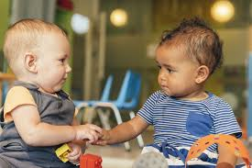
Methods
Sample selection: 60 children (10 boys and 10 girls from each tertile) were selected from a sample of 1,130 children from the NICHD Study of Early Child Care and Youth Development
Study participants: 60 parent-child dyads
Children’s mean age = 25.2 months
37% Black non-Hispanic (n=22) and 63% White non-Hispanic (n=38)
No significant differences in mother’s education
_ Income : needs ratio was less than 1.8 (low-income participants)
Price

Slide 44
Methods
Procedure
Expressive Language measured using the Reynell Developmental Language Scales
Three Boxes Task
15-minute video recordings scaled 1-7
Each of the three items (symbol-infused joint engagement, fluency and connectedness, and routines and rituals) was applied once to the 15-minute observation (Quality)
Maternal Maternal Words Per Minute (Quantity)
Sensitive Parenting
Price

Slide 45
Mean Ratings
Price

Slide 46
Results- Hypothesis 1
Children on the path to becoming successful language learners at 36 months (i.e., scoring in the top third of Reynell expressive-language norms) received significantly higher ratings on all three indicators of 24-month communication foundation quality than children in the bottom third of the language-outcome distribution
Quality communication is an indicator of successful language learning
Price

Slide 47
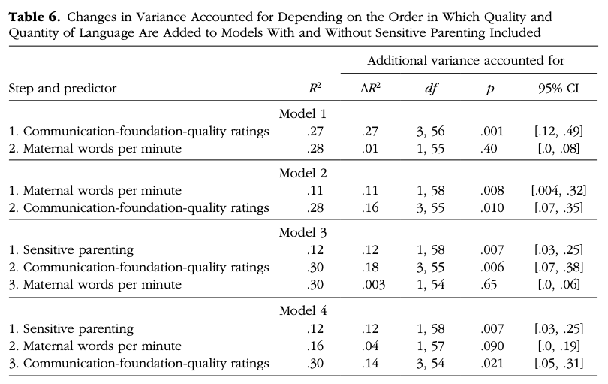
Results- Hypothesis 2
Quality ratings and maternal wpm at age 24 months accounted for 27.8% of the variance in child expressive language at age 36 months
Alone, quality ratings accounted for 26.9% of the variance
Quality ratings accounted uniquely for 16.4% of the variance, maternal wpm uniquely for 1.0%, with 10.4% accounted for by both jointly
Price

Slide 48
Results-Hypothesis 3
Communication-foundation-quality ratings account for more variance (30% in comparison to 27% and 28%), when controlling for sensitive parenting
Alone, sensitive parenting only accounted for 11.4% of the variance
When controlling for sensitive parenting, quality ratings accounted uniquely for an additional 13.6% of the variance, and maternal wpm accounted uniquely for an additional 0.3%, with an additional 4.1% accounted for by both jointly
Price

Slide 49
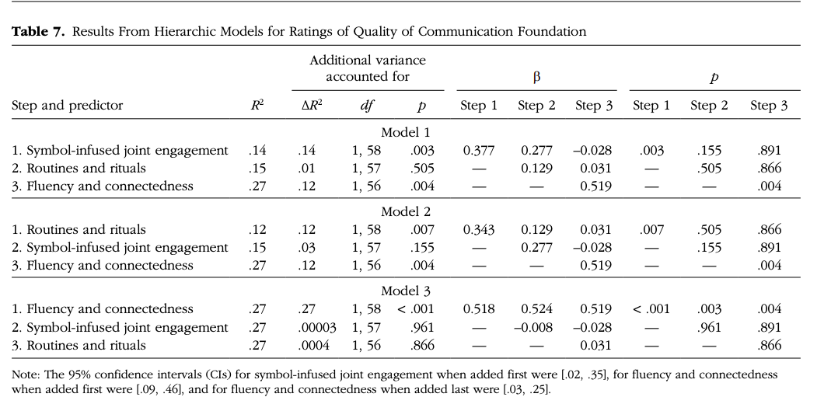
Results- Quality of Communication Foundation
When each rating was the only predictor in the model, fluency and connectedness accounted for the most variance in expressive language scores (26.9%), in comparison to routines and rituals (12%) and joint engagement (14%)
Price

Slide 50
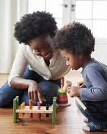
Conclusions
Fluent and connected conversations might be important for language development
Quality of early communication predicts expressive language over and above quantity and maternal sensitivity among children and parents from low-income households
Other potential control variables
Price

Slide 51
Discussion Questions
1. Authors speak very poignantly about the 30-million-word gap, yet their results show that communication quality, rather than quantity, better predicts expressive language outcomes. What do we make of this?
2. Besides those authors investigate, which factors might predict greater quality of language input directed towards infants? Do we think these might be individual-level factors (e.g., maternal depressive symptoms), or structural-level factors (e.g., greater instrumental support for childcare from family and friends)?
3. Since there may be other caregivers in the house while parents are at work, how might the type of caregiver influence authors’ results and expressive language outcomes, i.e., if they used grandma and grandpa, dad instead of mom, or aunt and uncle? And how might having these more varied social interactions benefit a child’s expressive language outcomes?
4. How do we think differences in expressive language based on quality of nonverbal and verbal interactions at 24 months predict expressive language in preschool, elementary, and middle school years, i.e., how might these results hold for later years?
5. Authors don’t mention participants’ language status, e.g., monolingual, bilingual. Thus, how would authors’ findings differ among children from bilingual homes?
6
Price

Slide 52
Results- RQ 1
Children who scored in the top third of expressive language norms had significantly higher ratings on all three indicators of 24-month communication quality than children in the bottom third
No significant differences in quantity

Slide 53
Results- RQ 2 & 3

Slide 54
Results- Exploring quality

Slide 55
Conclusions & Implications
Quality of early communication predicts expressive language over and above maternal sensitivity and quantity
Why?
Fluency and connectedness may be especially important for language development
Demonstrates what contributes to language success in a low income sample
Indicates the need to further clarify influential aspects of caregiver-toddler interactions on language development and develop interventions focused on encouraging a “conversational duet”

Slide 56
Houston et al. (2012)
Effects of early auditory experience on word learning skills
How does timing of exposure influence word learning?
Use of young children with cochlear implant to explore effects of deprivation
(like the cataract example for visual development)

Slide 57
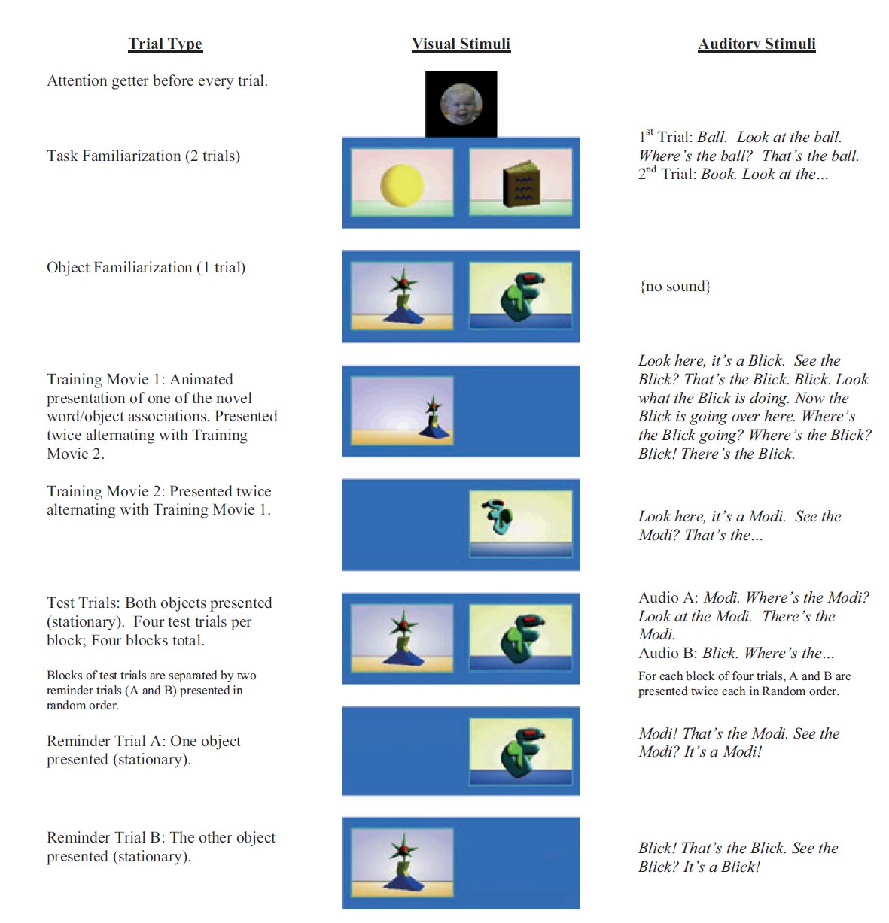
Houston et al. (2012)

Slide 58
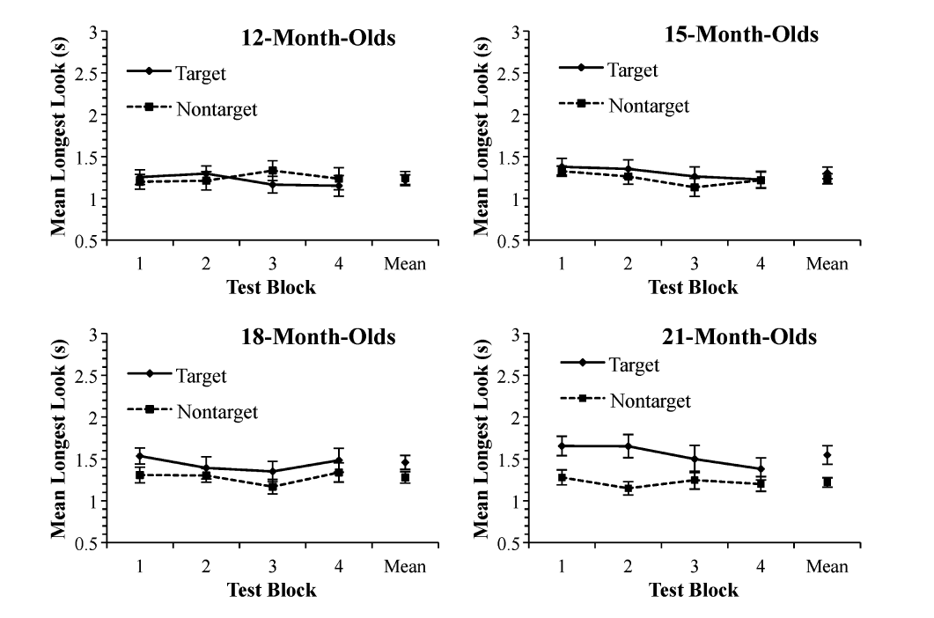
Houston et al. (2012)

Slide 59
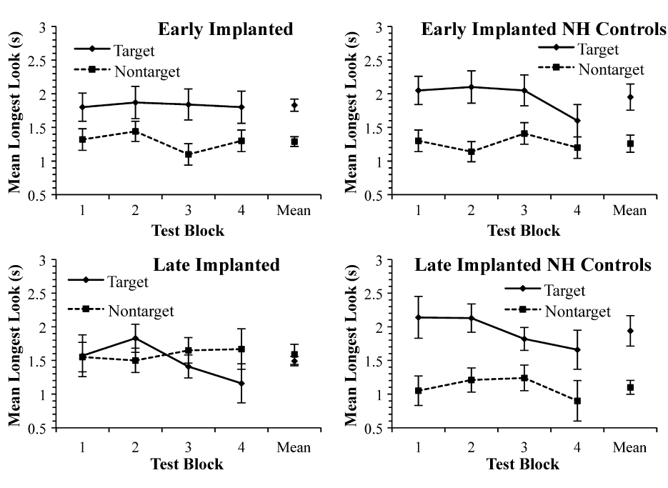
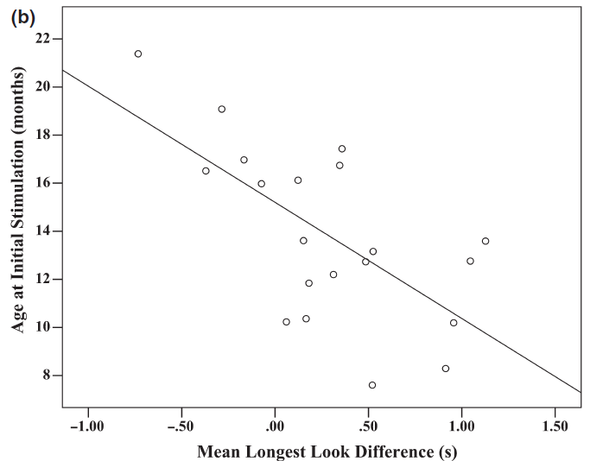
Early implantation, better discrimination
Age at implantation vs. chronological age matched controls

Slide 60
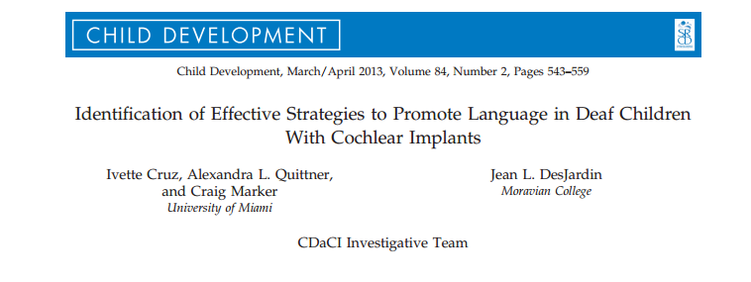

Slide 61
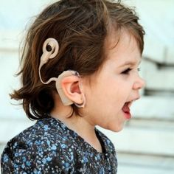
90% of children with hearing loss born to hearing parents
Maternal sensitivity
SES
Age of cochlear implantation
Duration of auditory deprivation
Parental linguistic input
Quantitative (Word types, Mean length of utterance)
Qualitative (Facilitative language techniques [FLTs])
Structured tasks better facilitators of oral communication
Notes:
Social Interactionist Theory of language development – young children learn language in the context of their daily experiences and interactions
Maternal sensitivity has been shown to significantly predict growth in oral language for deaf children
Children implanted earlier have better language outcomes
Better baseline hearing thresholds and a shorter history of hearing deprivation were associated with steeper increases in receptive and expressive language over 3 years
Higher SES and Maternal education predicted better receptive and expressive language skills in deaf children receiving cochlear implants
Quality of parental involvement have a major impact on growth of language development in children who are deaf
Both quantitative and qualitative linguistic input is associated with better receptive and expressive language outcomes in young, hearing children (kids learn words more rapidly when they frequently hear different types of words)
Higher level FLTs – recast, open ended question, parallel talk
Lower level FLTs – close ended questions, comment, directives

Slide 62
Hypotheses
The total number of word types would increase over time and be positively associated with improvements in language
Higher level FLTs would be more effective in fostering growth of language than lower level FLTs
Lower level FLTs would be used more frequently prior to cochlear implantation
Secondary aim: describe and compare the quantitative and qualitative strategies used by parents in structured and unstructured tasks

Slide 63
Methods
93 children 2 years of age and younger at pre-implantation
Baseline: 2-4 weeks prior to cochlear implantation surgery, with return visit 4-6 weeks later for implantation activation
Assessments at 6 months, 12 months, 24 months, and 36 months (6 month assessment not included in data)
Measures: demographics, Reynell Developmental Language scales, Videotaped interactions (one structured, one unstructured)
Notes:
Play in both structured and unstructured task was for 10 minutes, the first 5 minutes was coded
Unstructured: age-appropriate toys were provided and each parent-child dyad was told to play as they did at home
Structured: art gallery task – parents were asked to show child a series of art pictures mounted on the wall at different heights, were told to talk about the pictures for 5 minutes, and to determine which picture the child liked best

Slide 64
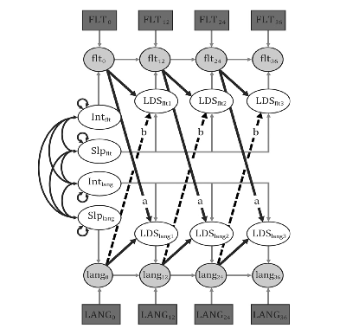
Analyses
Latent Growth Curve Modeling
Dynamic Bivariate Latent Difference Score Modeling

Slide 65
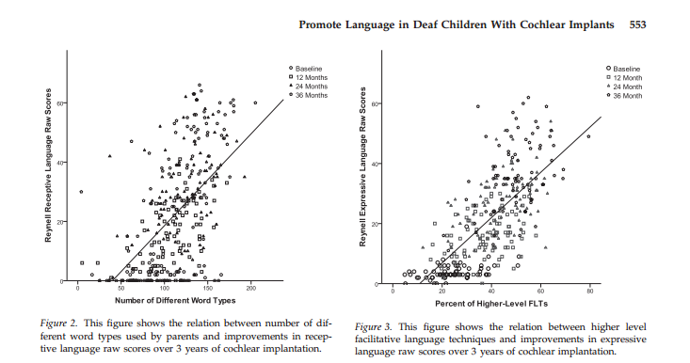
Parent language practices→ child language
Higher level FLTs – recast, open ended question, parallel talk
Lower level FLTs – close ended questions, comment, directives
Cruz, et al., 2013

Slide 66
Results
Structured tasks were better facilitators of oral communication
SES significantly predicted initial levels of expressive and receptive language, but not parental use of FLTs
SES was significantly related to number of word types at baseline and number of word types predicting expressive language, but not receptive
Use of lower level FLTs had no effect on expressive or receptive language
Total number of different word types predicted greater improvements in receptive language, but not expressive
Notes:
Structured tasks produced a higher amount of oral communication, but not higher quality
Lower level FLTs enhance language learning in young hearing children at the prelinguistic stage of development, but they did not appear to affect language learning in this sample

Slide 67
Clinical Implications
High quality parent-child interactions, using higher level FLTs and a variety of word choice are optimal for children’s oral language development in the first 3 years postimplantation
Parents with more limited education and income appear to be equally capable of using higher level FLTs compared to parents of a higher SES group (training should not be dependent on SES group)

Slide 68
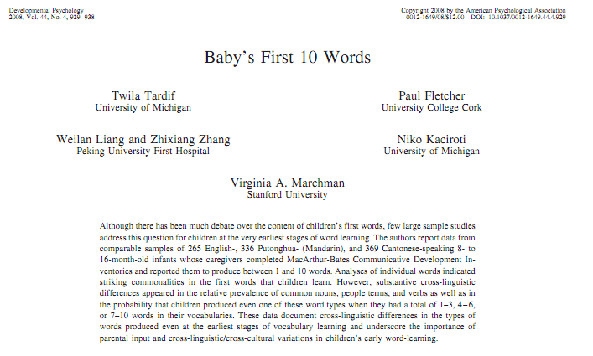
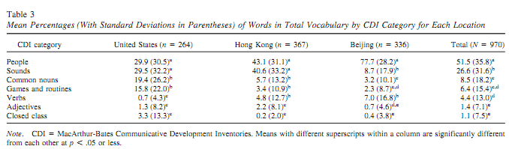

Slide 69

Overview
Examine variations in vocabulary composition as a function of vocabulary size specifically in early vocabulary development (first 10 words)
What categories of words do children first produce?
Is there a noun bias (people, objects, etc.)?

Slide 70
Sample
970 children learning:
American English
Mandarin Chinese
Cantonese Chinese
Children were sampled from the US, Hong Kong, and Beijing
Children were screened for a number of medical exclusion criteria
Parents of the children were native speakers of their particular language

Slide 71
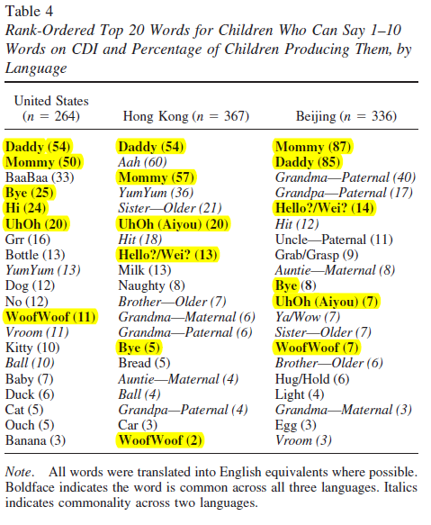
Similarities of Words Across Languages
6 of the top 20 words appeared in all three languages
Almost all categories had strong similarities in words that appeared
Children first learned nouns that were manipulable objects that they frequently encountered

Slide 72
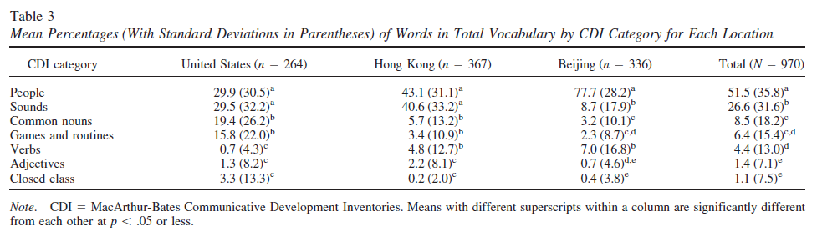
First 10 words
All 3 groups consistently produced people terms
Object and animal words varied across cultures
Most words were people and sounds/ sound effects
Fewest words in adjectives and closed class categories

Slide 73
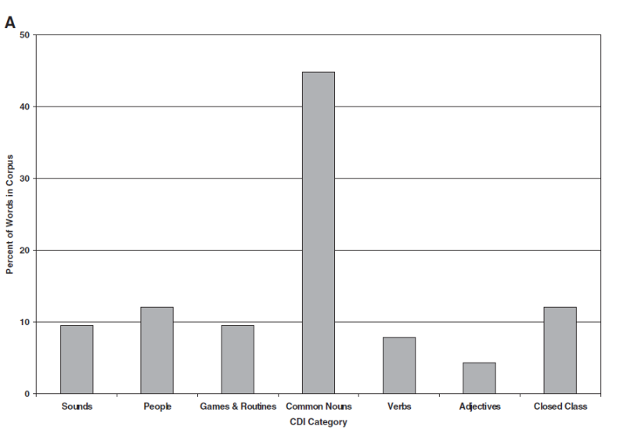
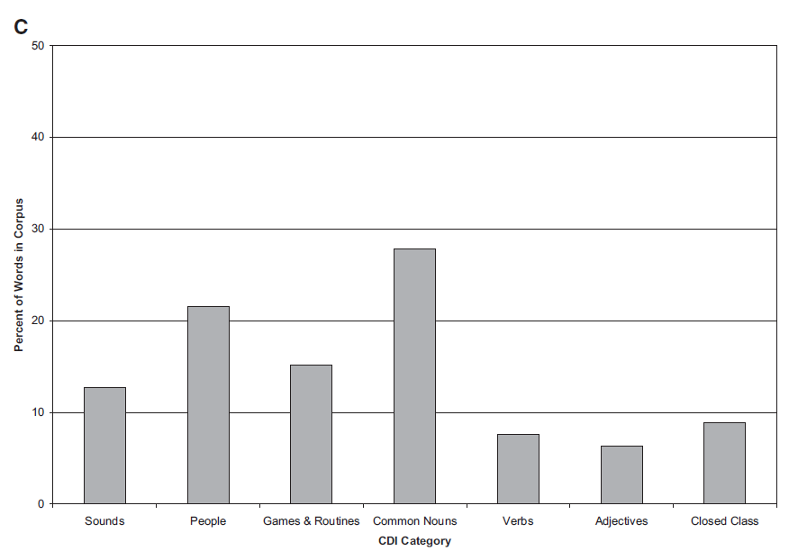
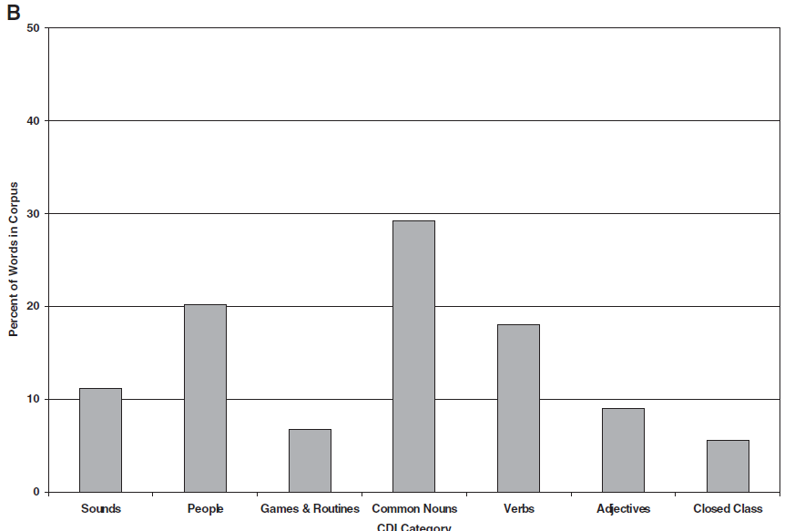
Proportions of Word Categories
Children from Hong Kong
Children from the US
Children from Beijing

Slide 74
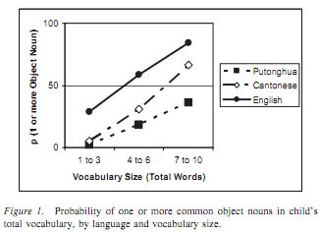
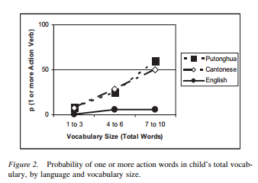
Cross-cultural differences in first words

Slide 75
Variability within Word Categories
Nouns: aside from people terms, manipulable objects and animals were the most common
Verbs: action verbs were most common
Descriptive Terms: state adjectives and adverbs (hot, slow, etc.) were most common
Other terms: “Hi” and “Bye” were the most common

Slide 76
Language Development Theories– Interactionist Perspective
Language development most likely occurs via interactions between inner capacities and environmental influences
Visual context of noun learning (shape bias)
Social context of language learning (performatives)
Auditory context
Statistical learning
Iconicity
Lynn Perry
First two theories are at the extremes of nature-nurture debate

Slide 77
Highchair philosophers: the impact of seating context-dependent exploration on children’s naming biases Lynn K. Perry, Larissa K. Samuelson, and Johanna B. Burdinie
Differences between solid objects and nonsolid substances lead to an early appreciation of their distinction
Does naming of nonsolids improve if children are tested in typical/familiar context of highchair during mealtime?
Children tested in the highchair demonstrated better understanding of how nonsolids are named, demonstrating a developmental cascade between
context, exploration, and word learning

Slide 78
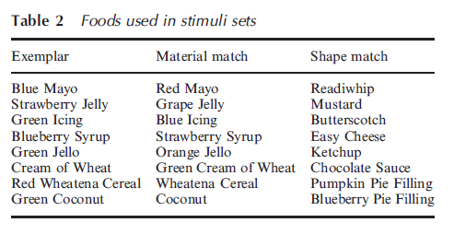
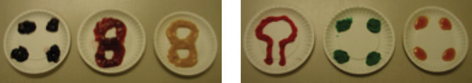
Child was given the exemplar object and the two test items to explore
experimenter asked children to find “their own” exemplar, either by name (warm up), with novel names (test), or with no name
Coded the final choice (shape versus material)
children classified via parental reports on messiness and whether they used a highchair or booster at home
Figure 1 Example stimuli sets used in experiment. Left panel shows a whole exemplar set; right panel shows a pieces exemplar set.

Slide 79
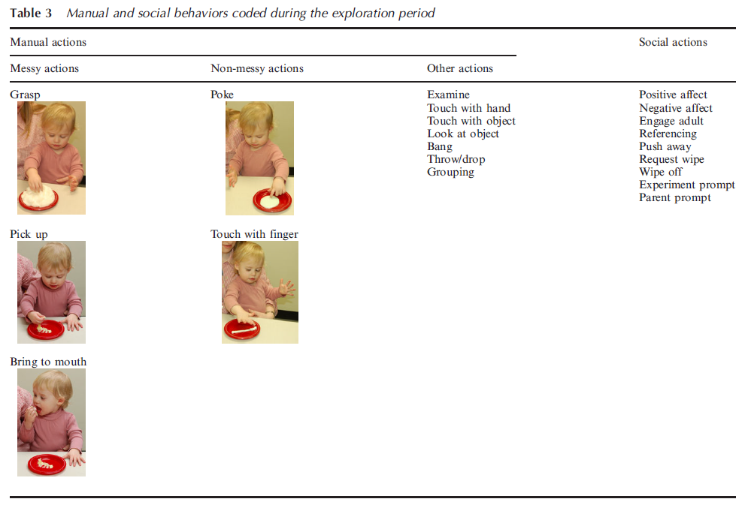

Slide 80
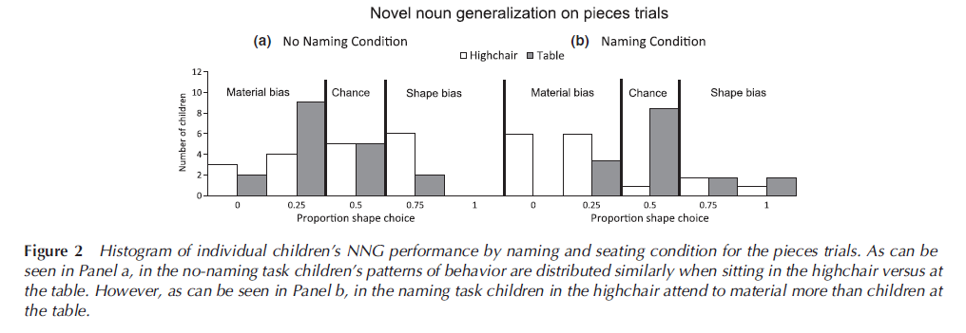
Highchair material bias

Slide 81
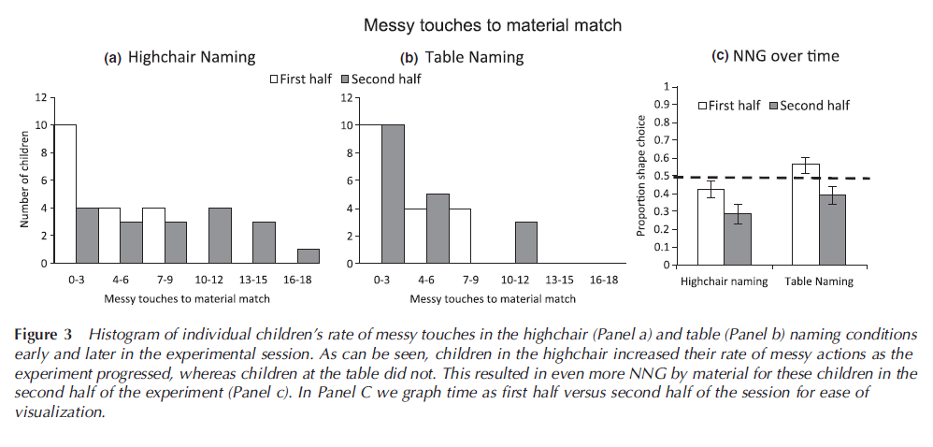
Related to increasing messy touches in high-chair

